Slide 1

Go, change the world
RV College of
Engineering
ARTIFICIAL INTELLIGENCE AND MACHINE LEARNING
(AI244AI)
Unit 5
Department Of AIML

Slide 2
Unit 5
Unsupervised Learning- Overview, What Is Cluster Analysis, Different Types of Clustering’s, Different Types of Clusters
K-means-The Basic K-means Algorithm, Additional Issues, Bisecting K-means, K-means and Different Types of Clusters, Strengths and Weaknesses, K-means as an Optimization Problem
Cluster Evaluation-Overview, Unsupervised Cluster Evaluation Using Cohesion and Separation, Unsupervised Cluster Evaluation Using the Proximity Matrix, Determining the Correct Number of Clusters, Supervised Measures of Cluster Validity, Assessing the Significance of Cluster Validity Measures, Choosing a Cluster Validity Measure

Slide 3
Partitional Clustering

Slide 4
Partitional Clustering
Given
A data set of n objects
K the number of clusters to form
Organize the objects into k partitions (k<=n) where each partition represents a cluster
The clusters are formed to optimize an objective partitioning criterion
Objects within a cluster are similar
Objects of different clusters are dissimilar

Slide 5
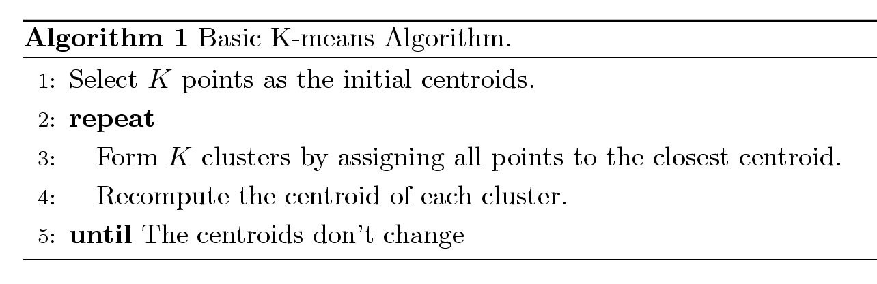
K-means Clustering
The basic algorithm is very simple
Number of clusters, K, must be specified
Each cluster is associated with a centroid (mean or center point)
Each point is assigned to the cluster with the closest centroid

Slide 6
K-means Clustering – Details
Initial centroids are often chosen randomly.
Clusters produced vary from one run to another.
The centroid is (typically) the mean of the points in the cluster.
‘Closeness’ is measured by Euclidean distance, cosine similarity, correlation, etc.
K-means will converge for common similarity measures mentioned above.
Most of the convergence happens in the first few iterations.
Often the stopping condition is changed to ‘Until relatively few points change clusters’ or some measure of clustering doesn’t change.
Complexity is O( n * K * I * d )
n = number of points, K = number of clusters, I = number of iterations, d = number of attributes

Slide 7
Evaluating K-means Clusters
Most common measure is Sum of Squared Error (SSE)
For each point, the error is the distance to the nearest cluster
To get SSE, we square these errors and sum them.
x is a data point in cluster C_{i} and m_{i} is the representative point for cluster C_{i}
can show that m_{i} corresponds to the center (mean) of the cluster
Given two clusters, we can choose the one with the smallest error
One easy way to reduce SSE is to increase K, i.e. the number of clusters
A good clustering with smaller K can have a lower SSE than a poor clustering with higher K

Slide 8
Two different K-means Clusterings
Original Points
Optimal Clustering
Sub-optimal Clustering

Slide 9
Importance of Choosing Initial Centroids (Case i)

Slide 10
Importance of Choosing Initial Centroids (Case i)

Slide 11
Importance of Choosing Initial Centroids (Case ii)

Slide 12
Importance of Choosing Initial Centroids (Case ii)

Slide 13
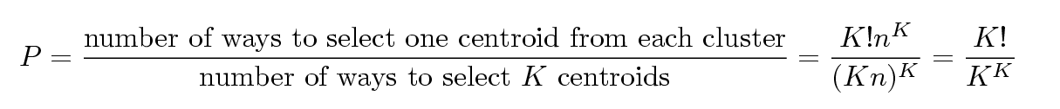
Problems with Selecting Initial Points
If there are K ‘real’ clusters then the chance of selecting one centroid from each cluster is small.
Chance is relatively small when K is large
If clusters are the same size, n, then
For example, if K = 10, then probability = 10!/10¹⁰ = 0.00036
Sometimes the initial centroids will readjust themselves in ‘right’ way, and sometimes they don’t
Consider an example of five pairs of clusters
Initial centers from different clusters may produce good clusters

Slide 14
10 Clusters Example (Good Clusters)
Starting with two initial centroids in one cluster of each pair of clusters

Slide 15
10 Clusters Example (Good Clusters)
Starting with two initial centroids in one cluster of each pair of clusters

Slide 16
10 Clusters Example (Bad Clusters)
Starting with some pairs of clusters having three initial centroids, while other have only one.

Slide 17
10 Clusters Example (Bad Clusters)
Starting with some pairs of clusters having three initial centroids, while other have only one.

Slide 18
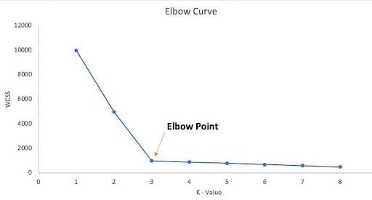
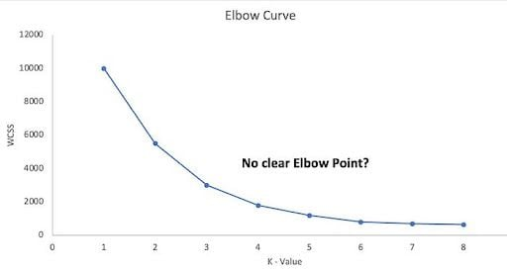
How to decide K clusters?
Elbow: graphical method for finding the optimal K value in a k-means clustering algorithm.
The elbow graph shows the within-cluster-sum-of-square (WCSS) values on the y-axis corresponding to the different values of K (on the x-axis).
So, in the majority of the real-world data sets, there’s not a clear elbow inflection point to identify the right ‘K’ using the elbow method. This makes it easier to find the wrong K.

Slide 19
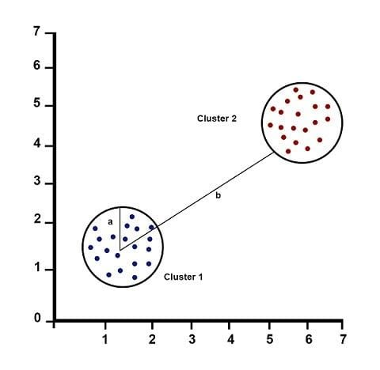
How to decide K clusters?
Why the Silhouette Method Is Better Than the Elbow Method?
The Silhouette score is a very useful method to find the number of K when the elbow method doesn’t show the elbow point.
The value of the Silhouette score ranges from -1 to 1.
1: Points are perfectly assigned in a cluster and clusters are easily distinguishable.
0: Clusters are overlapping.
-1: Points are wrongly assigned in a cluster.
Silhouette Score = (b-a)/max(a,b)
Where:
a = average intra-cluster distance, i.e the average distance between each point within a cluster.
b = average inter-cluster distance i.e the average distance between all clusters.

Slide 20
Solutions to Initial Centroids Problem
Multiple runs
Helps, but probability is not on your side
Sample and use hierarchical clustering to determine initial centroids
Select more than k initial centroids and then select among these initial centroids
Select most widely separated
Post-processing
Bisecting K-means
Not as susceptible to initialization issues

Slide 21
Pre-processing and Post-processing
Pre-processing
Normalize the data
Eliminate outliers
Post-processing
Eliminate small clusters that may represent outliers
Split ‘loose’ clusters, i.e., clusters with relatively high SSE
Merge clusters that are ‘close’ and that have relatively low SSE
Can use these steps during the clustering process
ISODATA

Slide 22
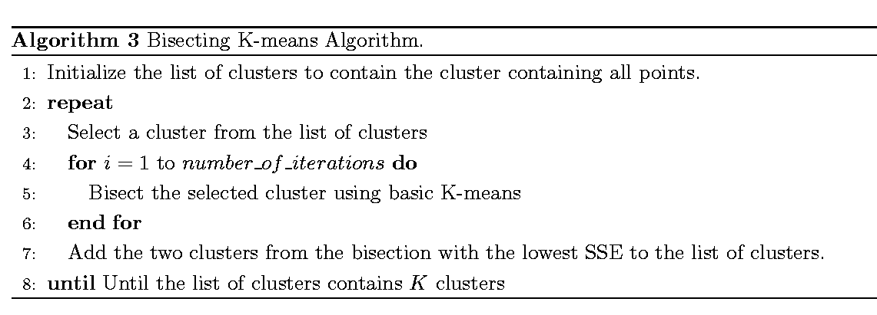
Bisecting K-means
Bisecting K-means algorithm
Variant of K-means that can produce a partitional or a hierarchical clustering

Slide 23
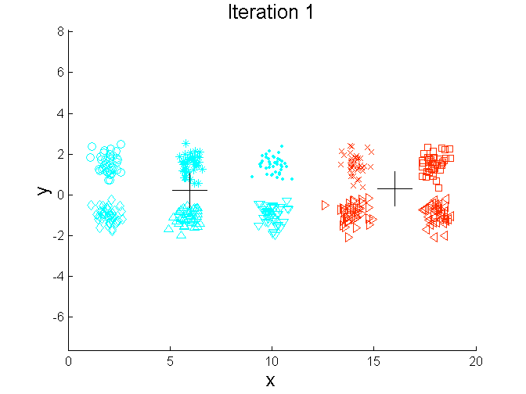
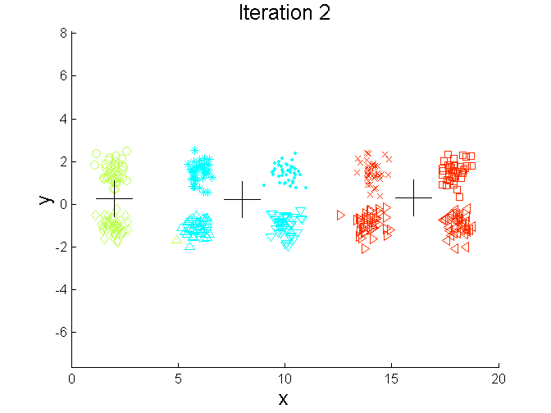
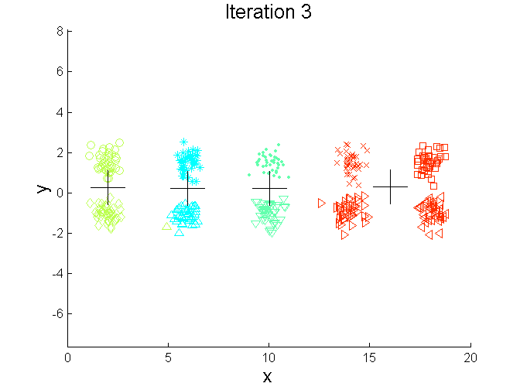
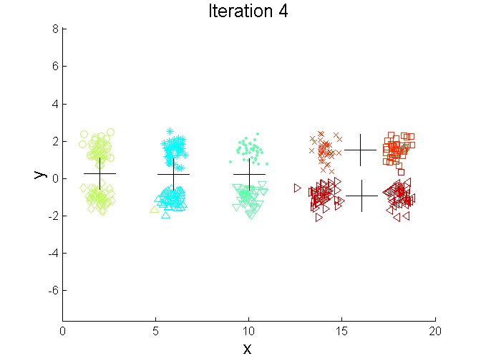
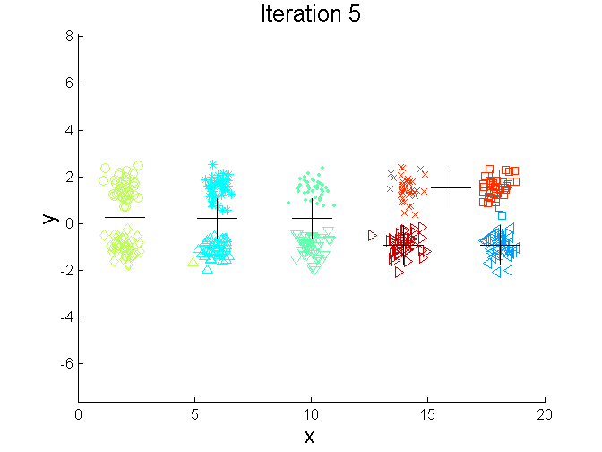
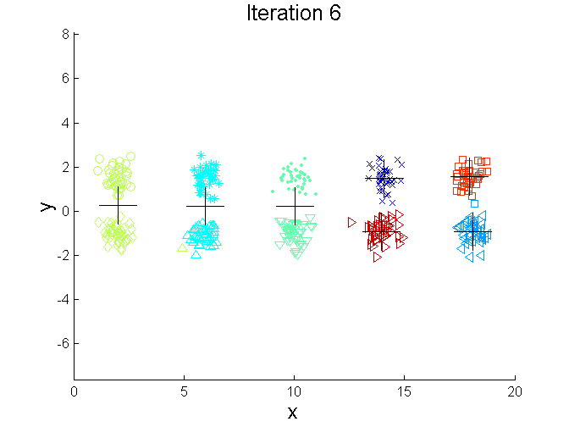
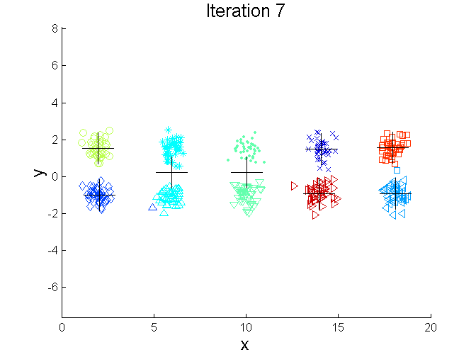
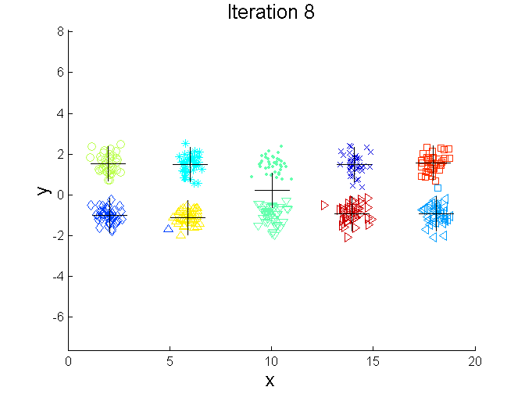
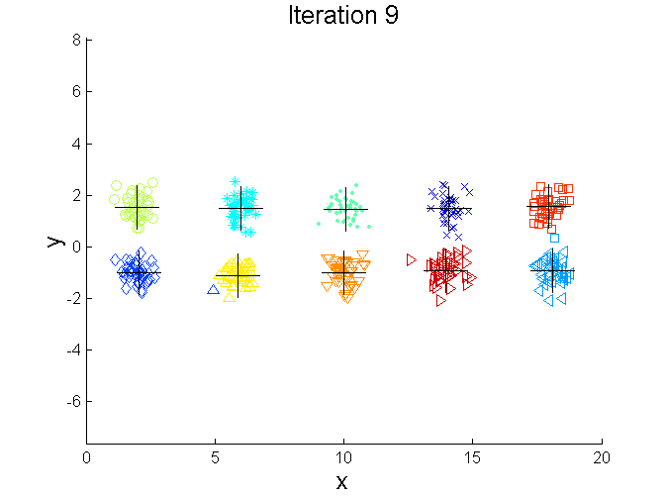
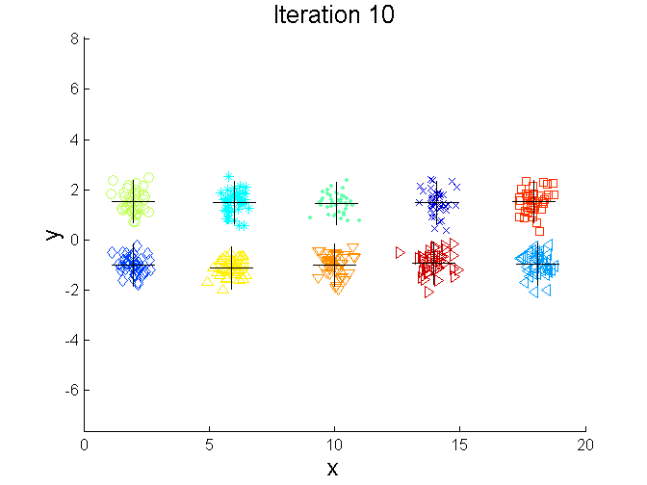
Bisecting K-means Example

Slide 24
Limitations of K-means
K-means has problems when clusters are of differing
Sizes
Densities
Non-globular shapes
K-means has problems when the data contains outliers.

Slide 25
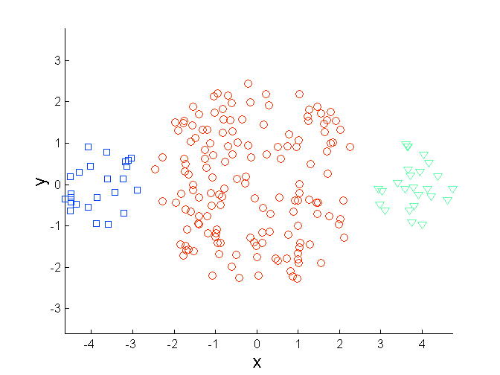
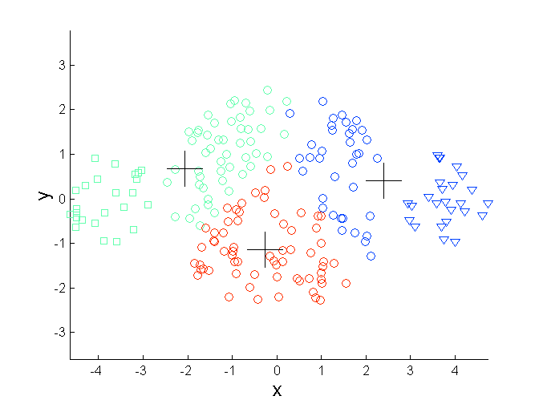
Limitations of K-means: Differing Sizes
Original Points
K-means (3 Clusters)

Slide 26
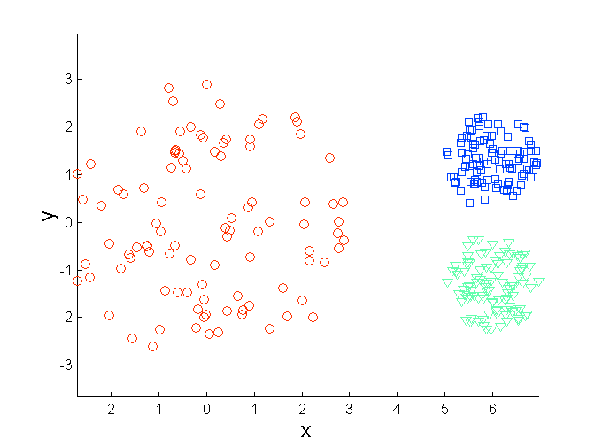
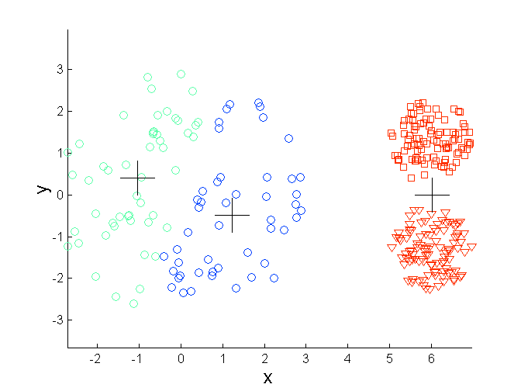
Limitations of K-means: Differing Density
Original Points
K-means (3 Clusters)

Slide 27
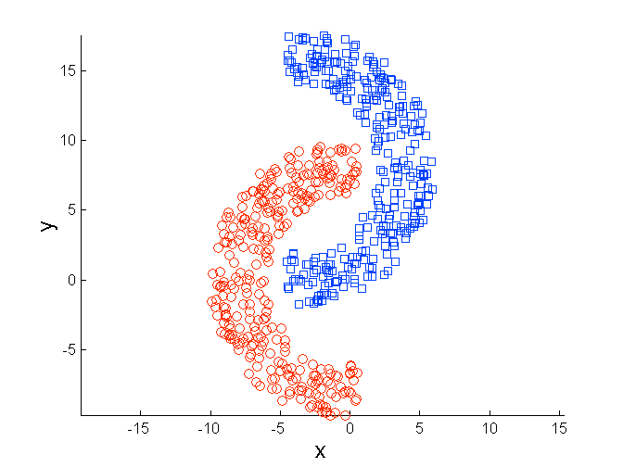
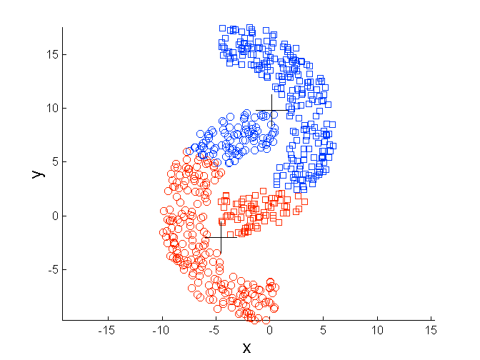
Limitations of K-means: Non-globular Shapes
Original Points
K-means (2 Clusters)

Slide 28
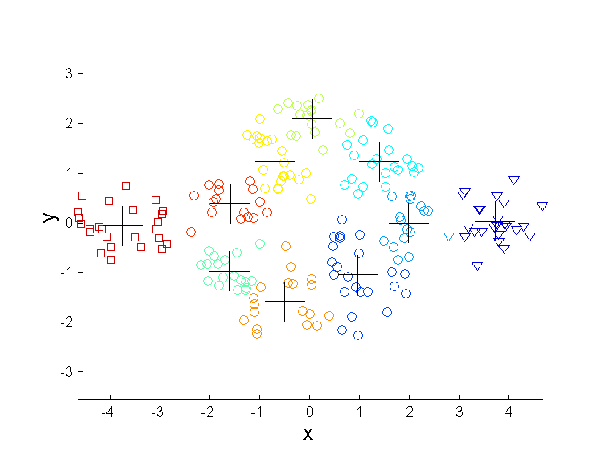
Overcoming K-means Limitations
Original Points K-means Clusters
One solution is to use many clusters.
Find parts of clusters, but need to put together.

Slide 29
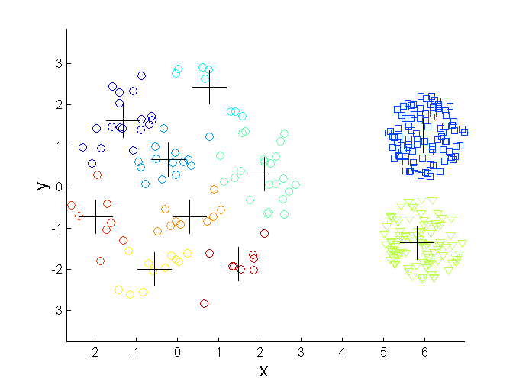
Overcoming K-means Limitations
Original Points K-means Clusters
One solution is to use many clusters.
Find parts of clusters, but need to put together.

Slide 30
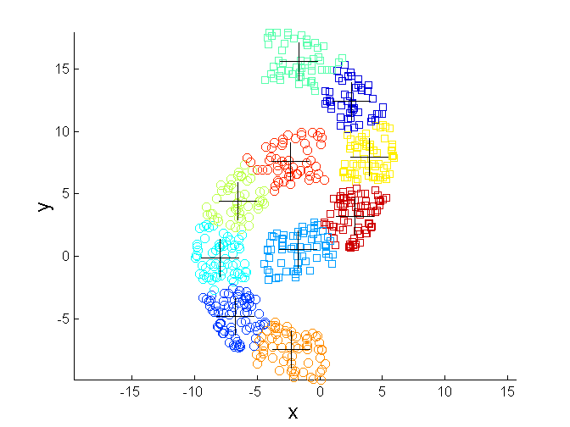
Overcoming K-means Limitations
Original Points K-means Clusters
One solution is to use many clusters.
Find parts of clusters, but need to put together.

Slide 31
Limitations of K-means: Outlier Problem
The k-means algorithm is sensitive to outliers !
Since an object with an extremely large value may substantially distort the distribution of the data.
Solution: Instead of taking the mean value of the object in a cluster as a reference point, medoids can be used, which is the most centrally located object in a cluster.
10
10
9
9
8
8
7
7
6
6
5
5
4
4
3
3
2
2
1
1
0
0
1
2
3
4
5
6
7
8
9
10
0
0
1
2
3
4
5
6
7
8
9
10

